Slide 1

Concordia Institute for Information System Engineering (CIISE)
‍Concordia University
INSE 6170 Network Security Architecture and Management
Project 1: Scan the IoT devices
Submitted to: Professor Carol Fung
Submitted by:
Aniket Agarwal | 40266485
Kalyani Batle | 40243967

Slide 2
Objectives
Target operating system – Windows 10
Scan our Wi-Fi network for active IoT devices
Provide IP and MAC address about each discovered device
Enable users to input device information and capture packets
Save captured packets in a pcap file format
Save pcap filename with the device info in database for 10 IoT devices.

Slide 3
IoT Devices
IoT Devices are everyday objects embedded with sensors, software and connectivity to exchange data over the internet.
It has wide range.
Each IoT device has a public IP over the internet and a respective MAC address.

Slide 4
Tools and Libraries Used to Scan Wi-Fi network for IoT Devices
Python3
PyQt5 (for GUI interface)
Scapy to send ARP requests to discover IoT devices and capture packets to and from a specified device in the network.
Requests to send API request to mavendors.com to get the vendor details of respective MAC addresses of the devices discovered.
Sqlite3 to store filename and respective IP of device in the database.

Slide 5
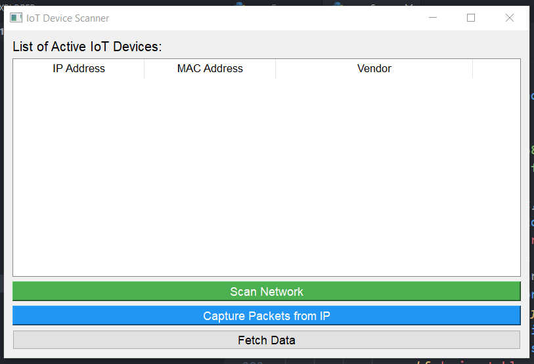
PyQt5
Python library to create cross-platform desktop applications with GUI.
Offers wide range of widgets, layouts and tools for building sophisticated desktop apps.

Slide 6
Scapy
Powerful Python Library for packet manipulation and network analysis.
Allow packet capturing, send and receive packets on a network.
Makes network discovery easier with Python.

Slide 7
Sqlite3
In-built library in python to create database instances.
No need to maintain a separate database server.
Lightweight solution for small to medium sized applications.

Slide 8
Algorithm to Scan Wi-Fi Network
Scapy generates an ARP object having destination address as IP range of local Wi-Fi network.
Generate Ethernet object having destination MAC address as broadcast address to send ARP request to all IP in network.
Packet is created and send using srp function of scapy.
Packets received are noted and device info is stored and displayed using PyQt5 GUI interface.

Slide 9
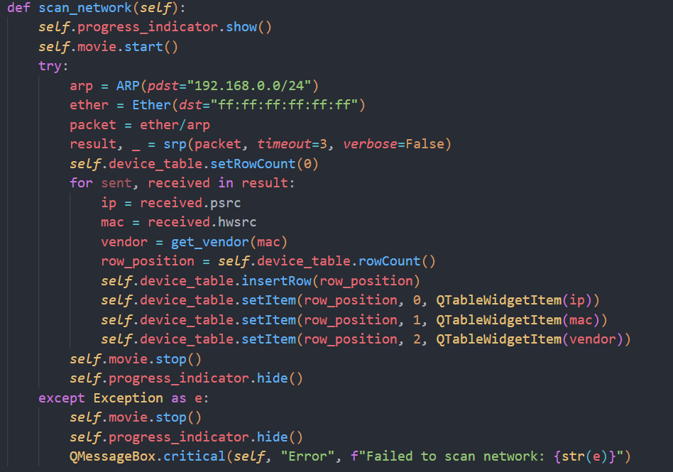
Source code for Scanning network

Slide 10
Algorithm to Capture Packets through a Device
Scapy uses sniff() to capture the packets through a specific device.
First, packets are filtered based on the device IP as src or dst fields and presence of IP layer.
Next, packets are captured based on the packet count given by the user.
Lastly, the packets are stored in a pcap file using wrpcap() function of scapy and stored in the database using sqlite3 INSERT statement.

Slide 11
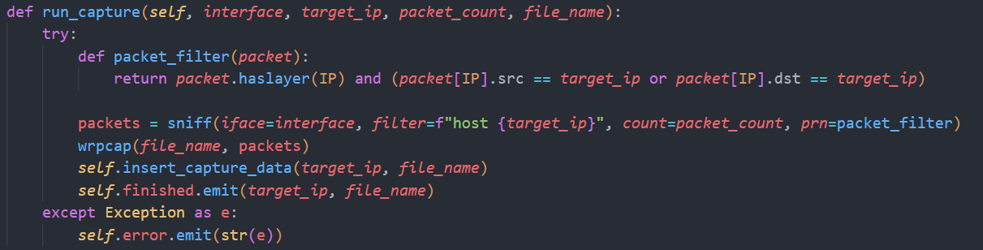
Source code for Packet Capture

Slide 12
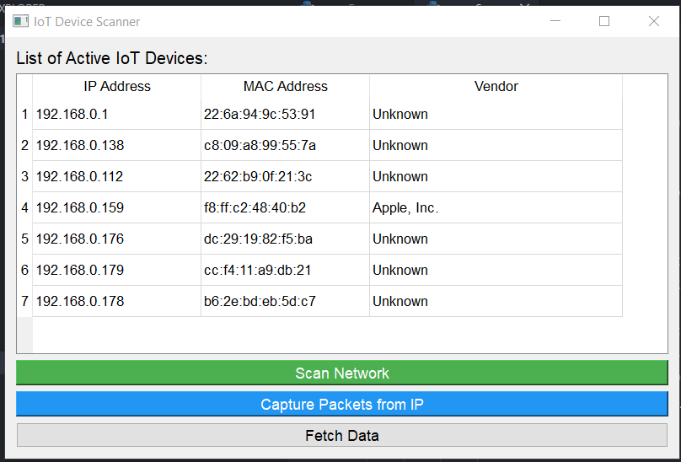
Displaying Device Information
IP Address
MAC Address
Vendor Details

Slide 13
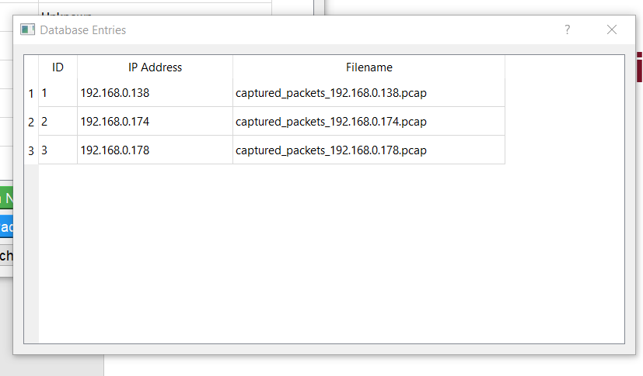
Displaying Stored Device Info in Database
IP Address
Packet filename

Slide 14
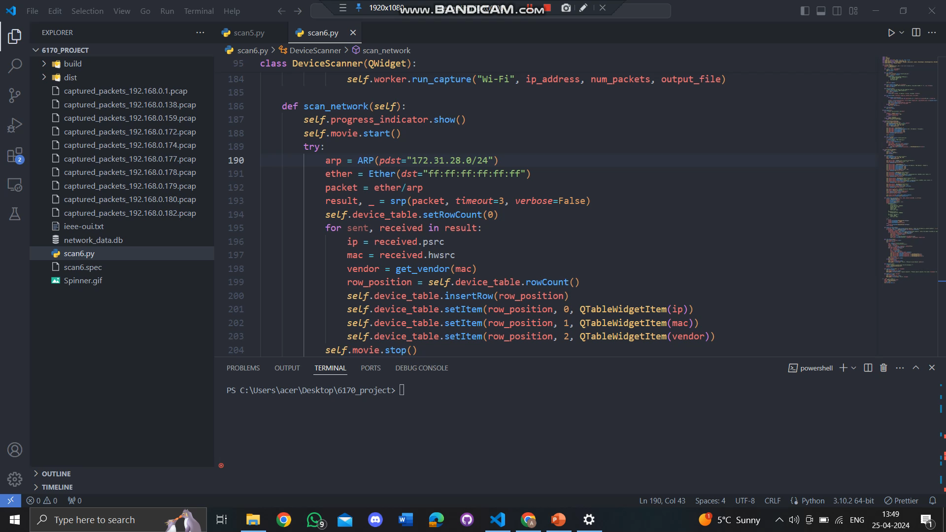
Implementation Demo

Slide 15
Conclusion
In conclusion, the provided application effectively fulfills the specified requirements for scanning a Wi-Fi network for active IoT devices, capturing packets, and saving device information along with the captured packets.
the application effectively combines the functionalities of network scanning, packet capturing, and database management into a coordinated solution. It provides users with a convenient way to discover and monitor IoT devices on their Wi-Fi network while also facilitating packet capture for further analysis.

Slide 16
Individual Contribution of Each Team Member
Name | Contribution
Aniket Agarwal (40266485) | Researched about tools to use Implemented PyQT5 code to make GUI interface Prepared presentation slides
Kalyani Batle (40243967) | Researched about tools to use Implemented code to scan network and display discovered IoT devices Prepared presentation slides

Slide 17
THANK YOU

